Slide 1
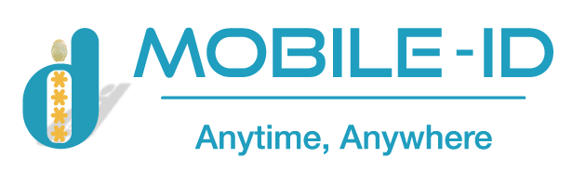

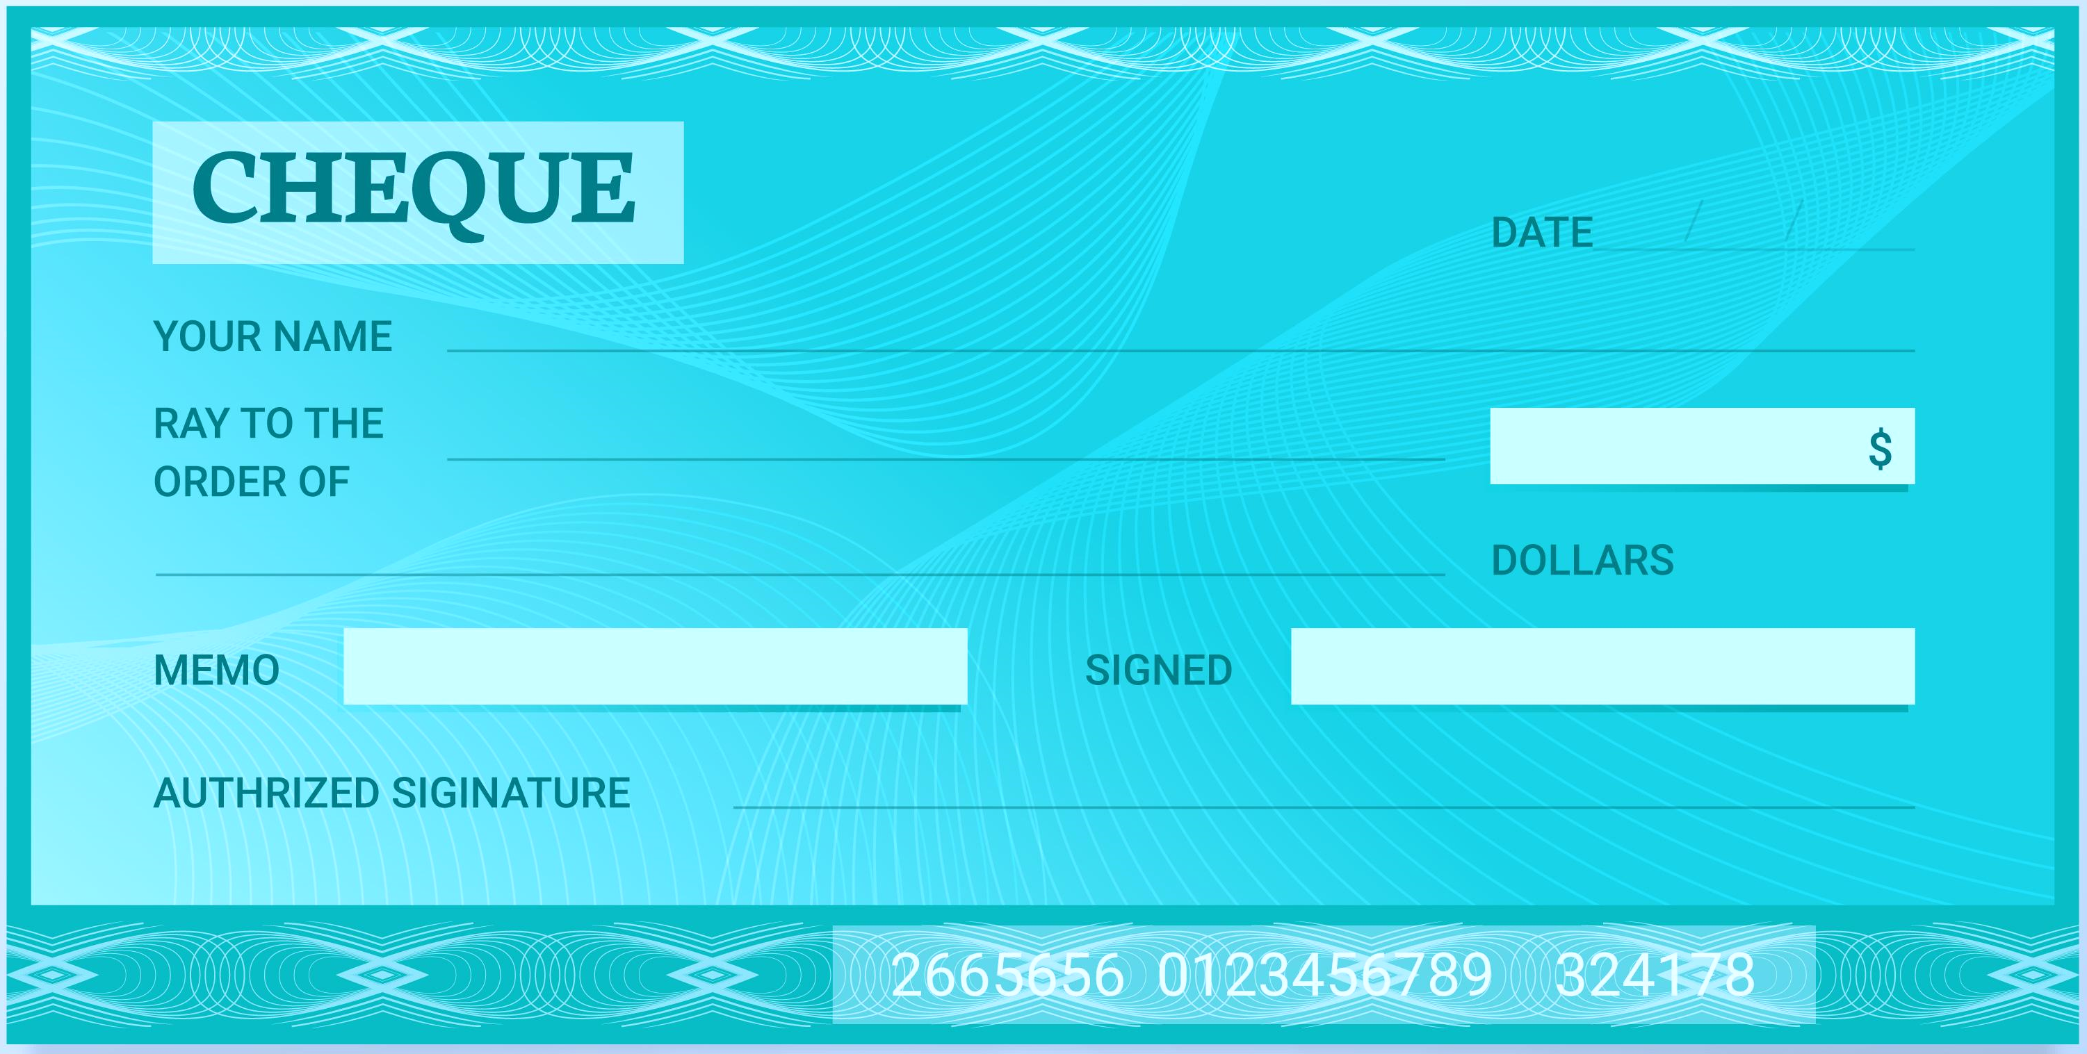
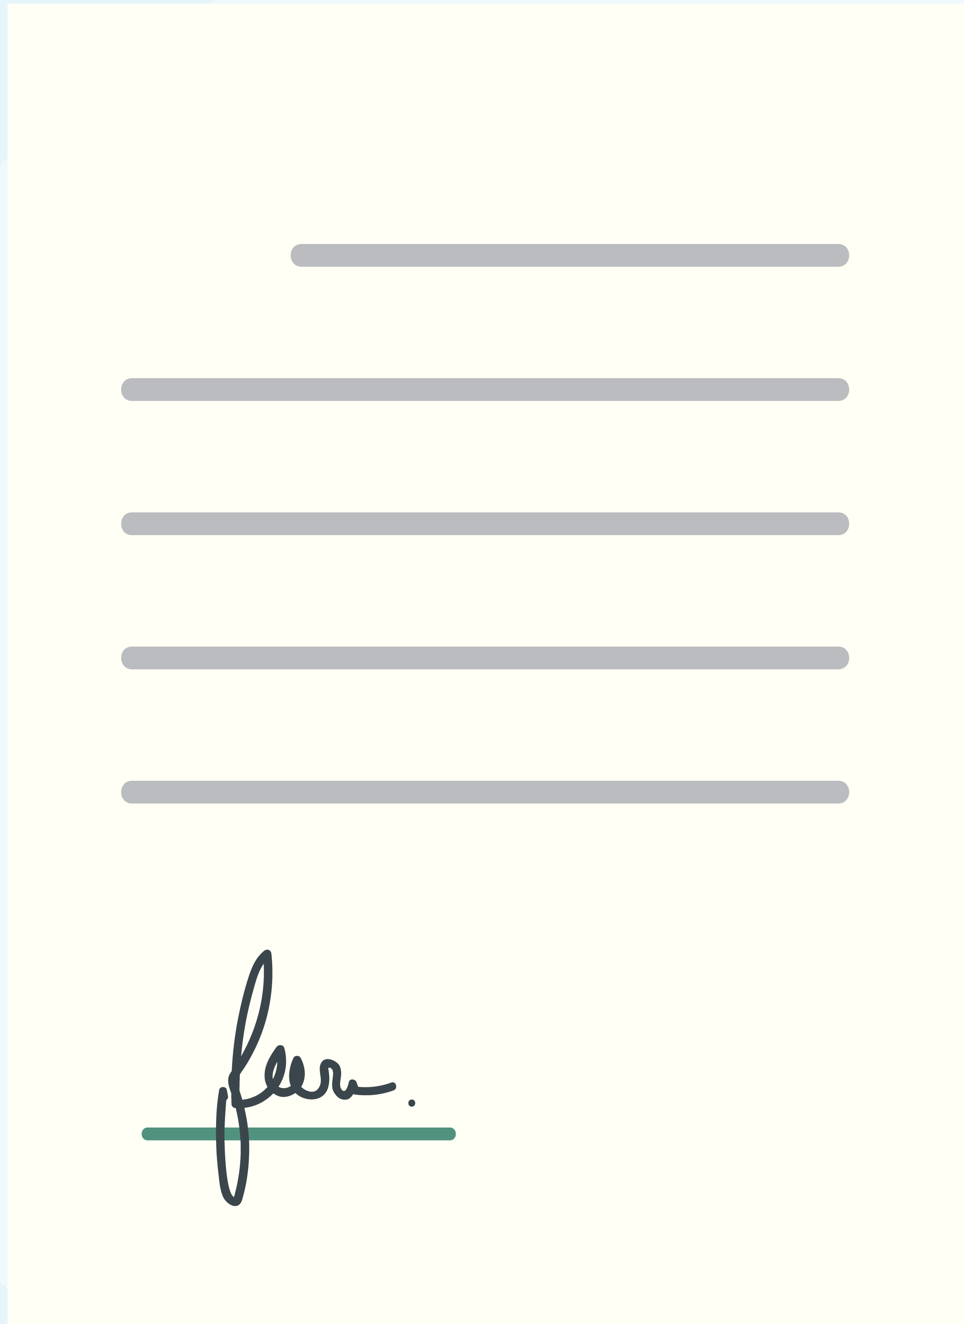
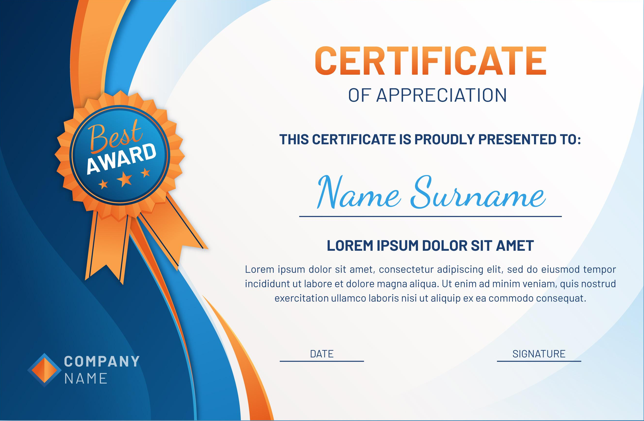
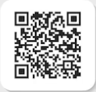
WHITEPAPER
on
DOCUMENT
SECURITY
NEED A MATER PLAN?

Slide 2
Table of Contents
01
02
03
04
Document Security
02
Introduce - Reimagining Document Security
Why is Document Security Important?
04
01
03
Problem & Solution
Problem statement
Solution for Securing Document
QR System
Choosing – Implementation – Elements
Generation & Validation architecture
Seamless Verification Experience

Slide 3
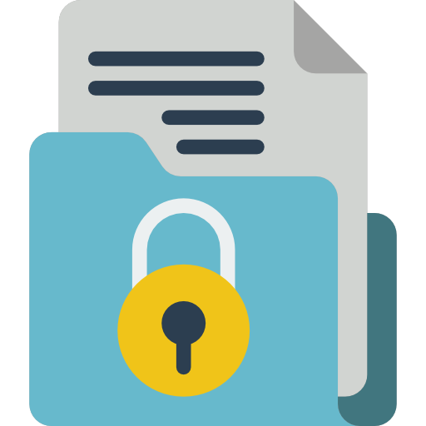


01
Document Security

Slide 4
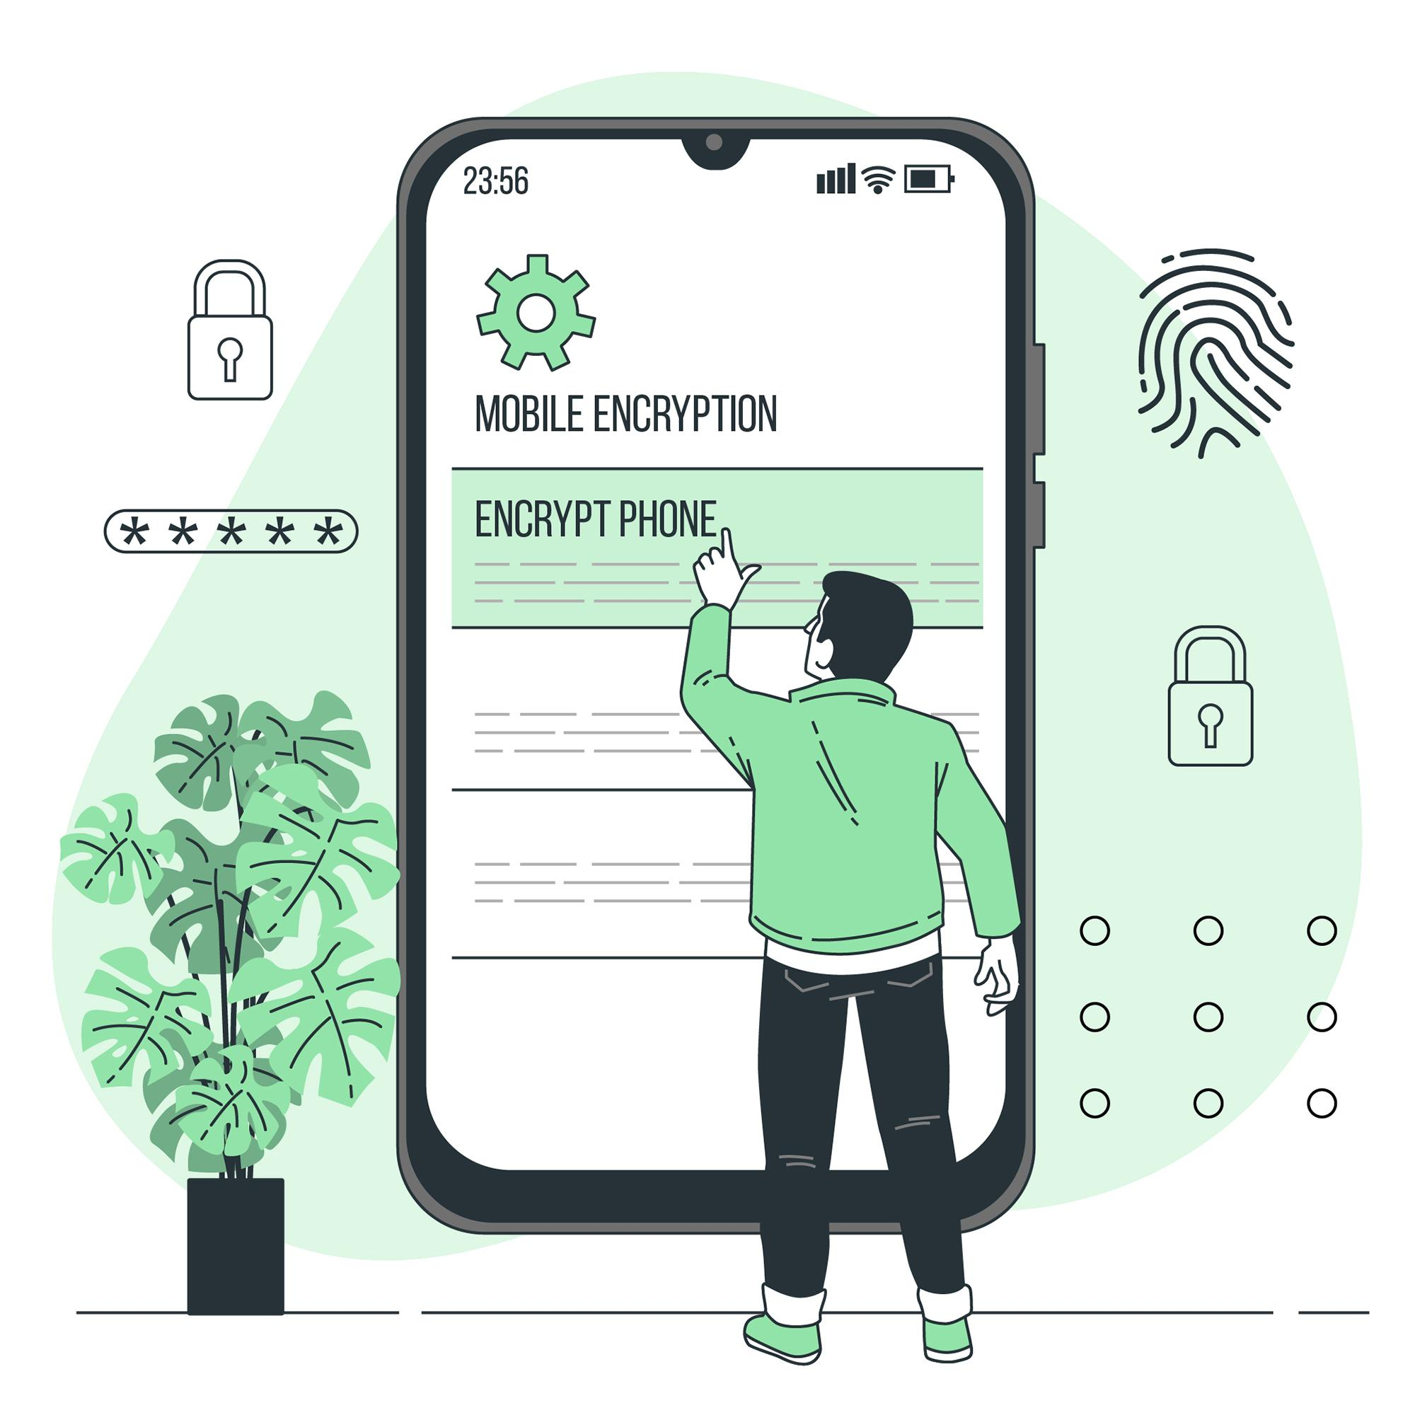

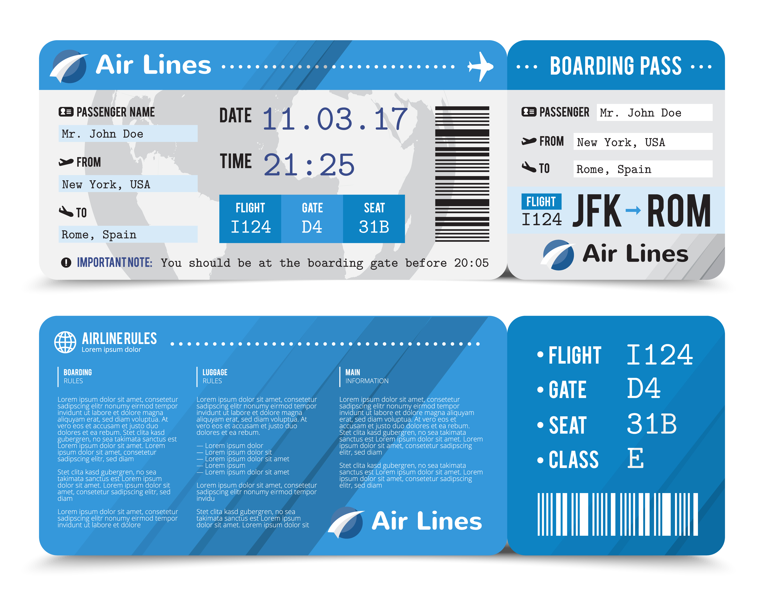
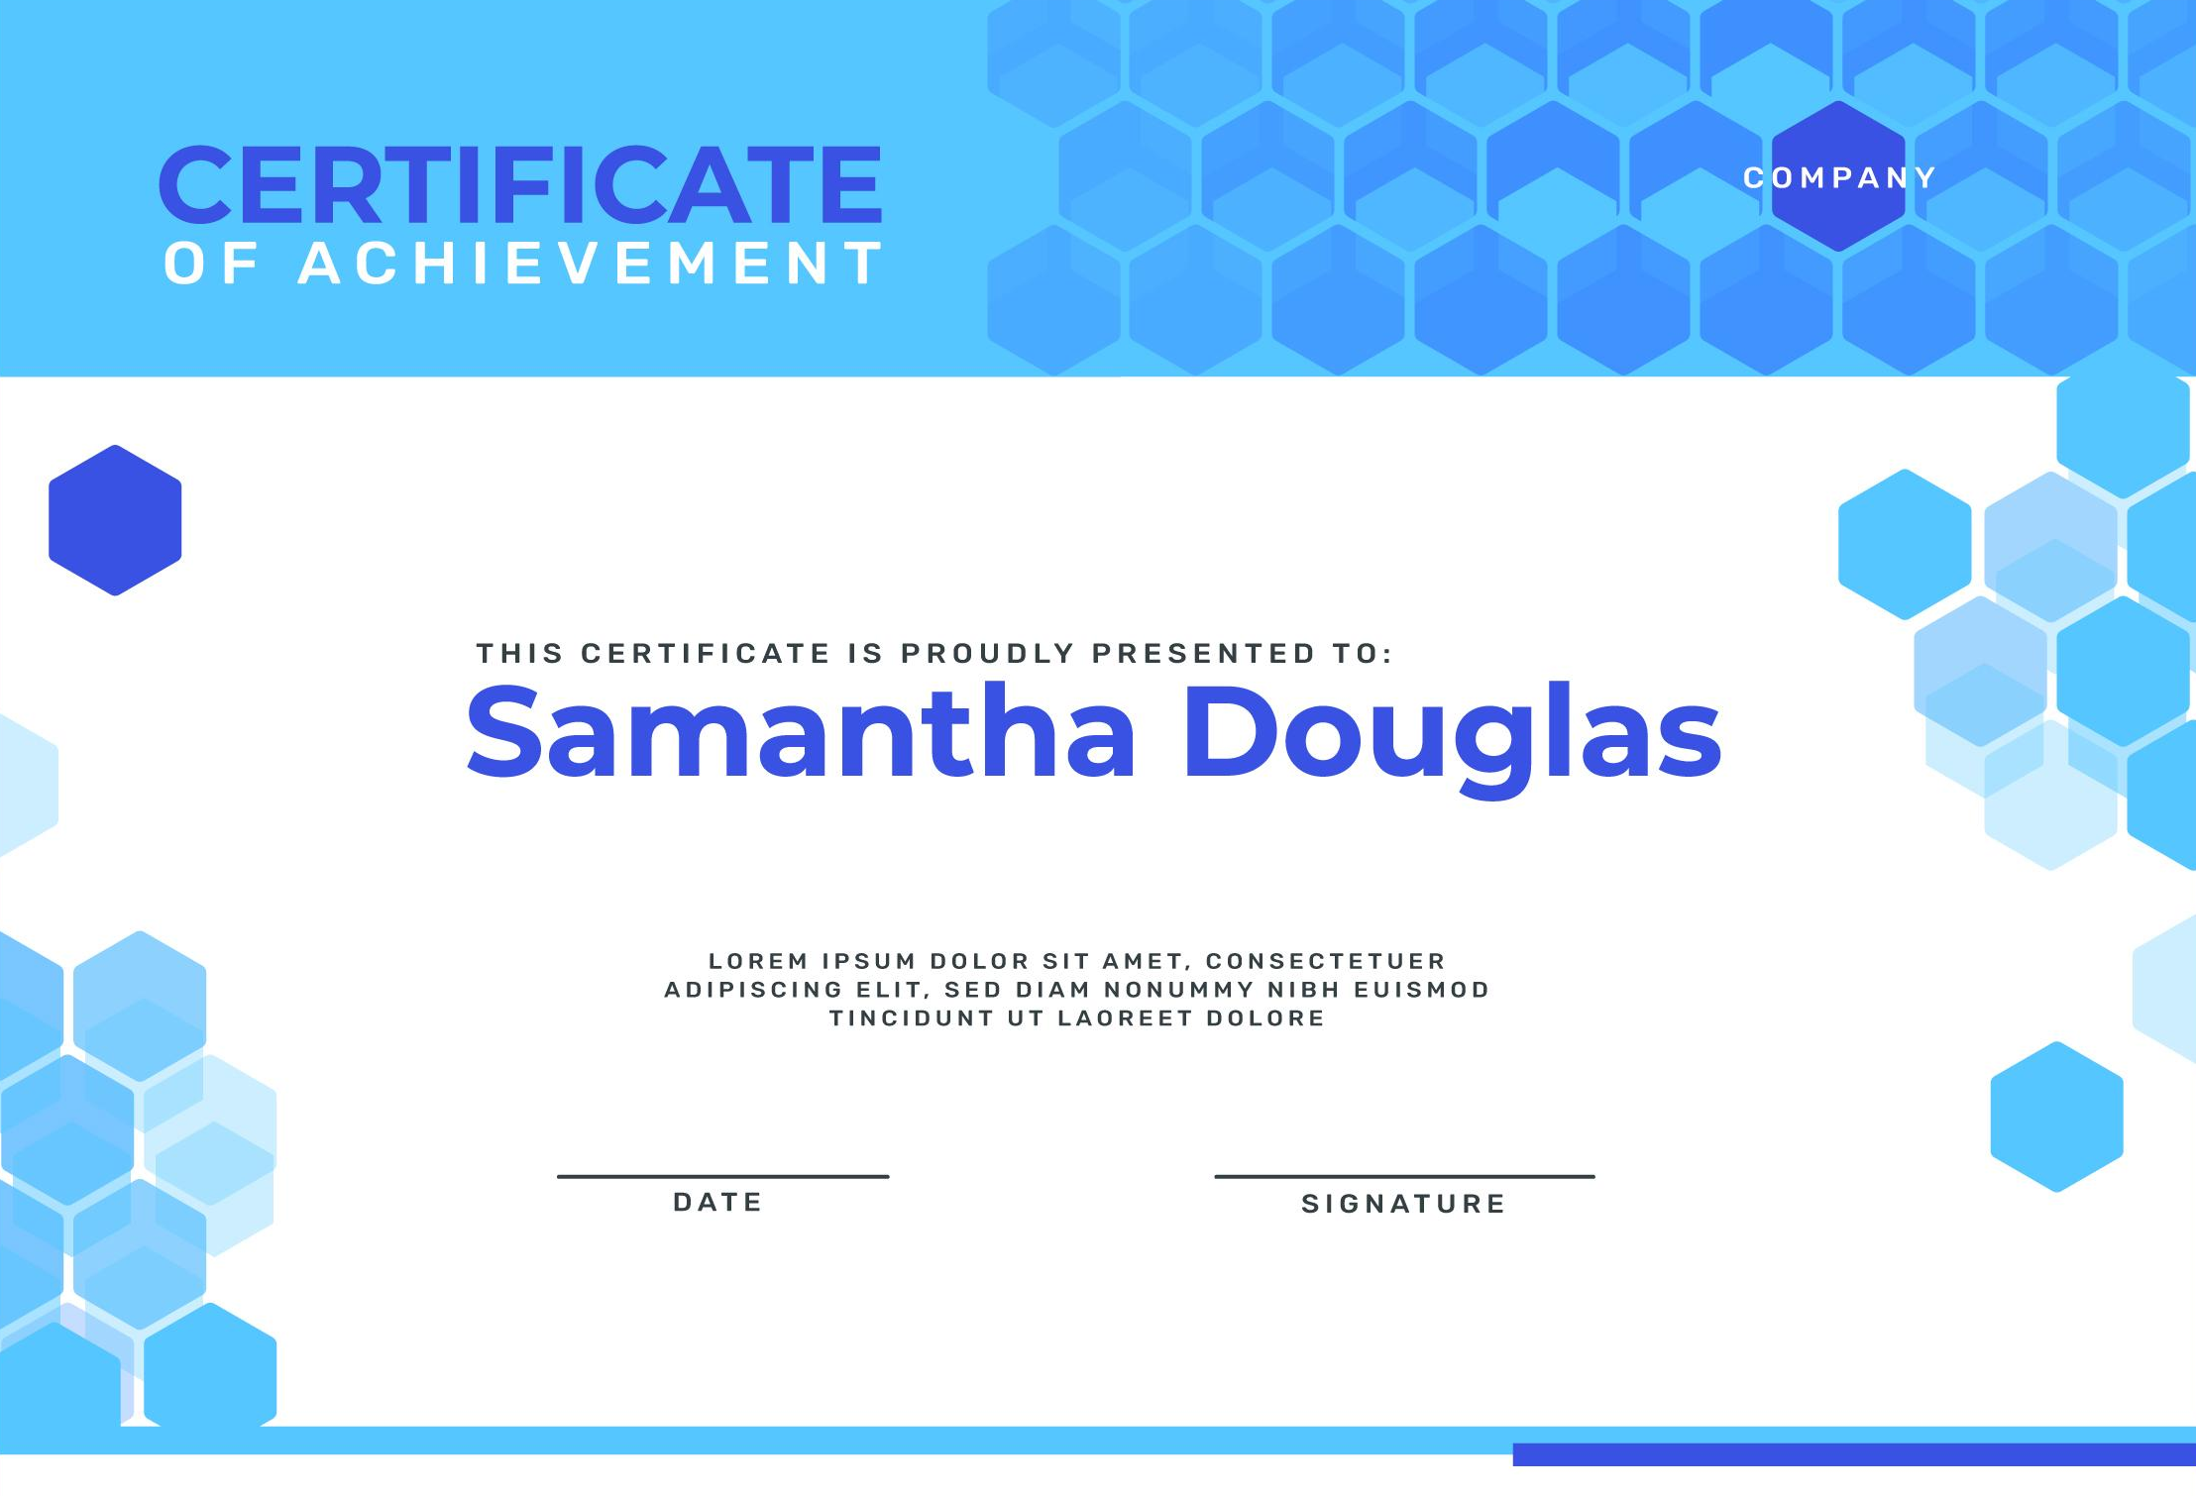
01
INTRODUCTION
Brand authentication
The secure documentation industry
Corporate Documentation
Changes Extend
Ticketing
Healthcare
Invoicing
Banking
Trade Finance
Personal identification
Widely accepted
Continue to drive innovation and transformation in the industry
Laboratory Certification

Slide 5
REIMAGINING DOCUMENT SECURITY
01
“
Document security is safeguarding the integrity of a document's information to ensure trust, integrity, and authenticity.
Loss information
Confidence
Facilitate Compliance
Data tampering
Document is from the orginating organization
Legal requirement
Smoothens economic transactions
Altered or modified unauthorizedly
Physical or digital form
Preserve the integrity Tamper-proof for the verifier Efficient way to verify the authenticity and integrity

Slide 6










WHY IS DOCUMENT SECURITY IMPORTANT?
Data Protection
Risk Reduction
Trust - Building and Maintenance of Trust
Reputation
Customer Confidence

Slide 7

Problem & Solution
02

Slide 8



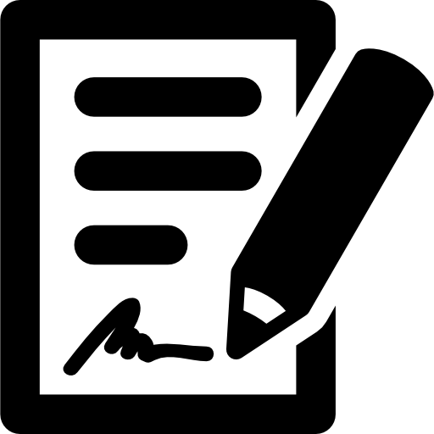

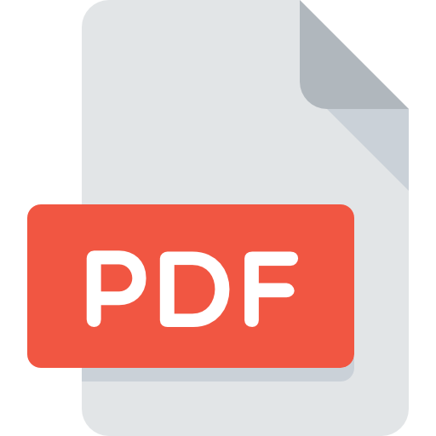


PROBLEM STATEMENT
02
Traditional Method
Prone to forgery due to technological advances
Documents' authenticity
Digital Document
Integrity
Confidentiality
Digital documents are found wanting in the physical documents
Physical documents are found wanting in the digital versions
X
Become pervasive
Further complicate document security and easier to duplicate and tamper.

Slide 9






PROBLEM STATEMENT
02
The increasing need for secure and tamper-proof documentation in various industries
The rise of fraud and counterfeit documents in various vectors, such as education and finance
The challenges of traditional method of document verification, such as time-consuming and manual effort
Tedious processes and potential for human error
The increasing demand for digital and mobile-enabled solutions document security
The need for a more efficient and reliable document verification method to ensure the authenticity and integrity of official document

Slide 10

PROBLEM STATEMENT
02
Explore the various challenges and opportunities
More secure, efficient, and cost-effective
Integrated into existing systems and processes
Provide a comprehensive overview of the latest technologies and best practices
WHITEPAPER

Slide 11
SOLUTION FOR SECURING DOCUMENT
02
1
2
3
Digital signatures
Secure QR codes
Blockchain technology
Secure and verify the authenticity of a document

Slide 12


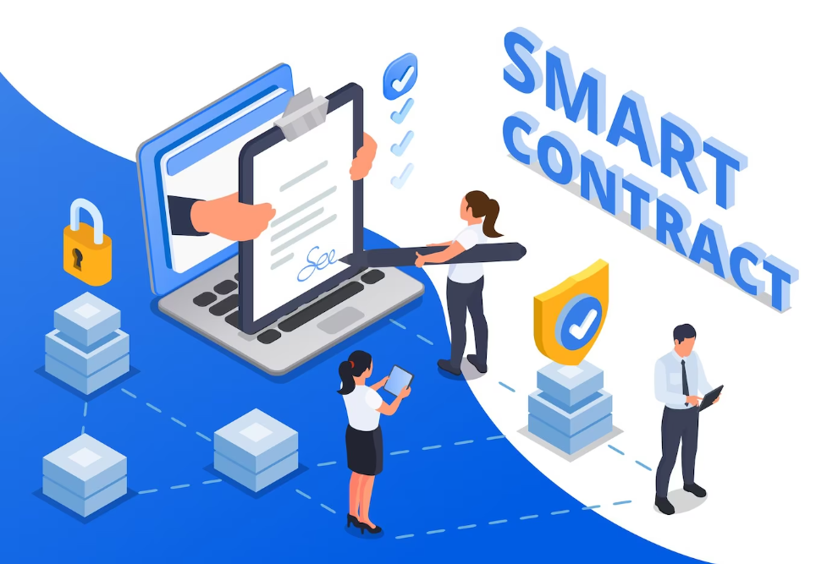
Digital signatures
02
Verify the authenticity and integrity of digital PDF documents
Use cryptography to create a unique signature tied to the document and the signer
Secure and verify the authenticity of a document
A cumbersome process
Verify only the right software on the right platforms
Used default PDFs viewers on mobile phone cannot verify these digitally signed documents
Can no longer be verified once the document is printed and presented physically

Slide 13

Blockchain
02
A distributed ledger technology use cryptography to secure transactions and data
Indirectly verify the authenticity and integrity of a document
Create tamper-proof records of transactions and other data, such as digital assets
Proposed as a means to secure documents
The resources needed, both in energy and monetary
It is not a popular choice for businesses to implement

Slide 14
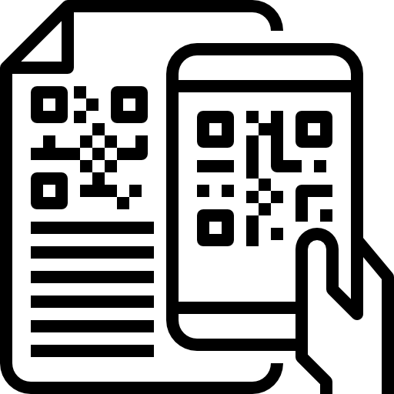
Create a unique digitally signed QR code tied to the document and the issuer
Secure QR Codes
02
Use to verify physical and electronic documents, including copies of the documents
The best features of all other options and more in an easy-to-implement, use, and cost-effective package and suitable for a wide range of use cases and industries
Third party
A method of verifying the authenticity and integrity of physical documents

Slide 15

03
QR SYSTEM

Slide 16
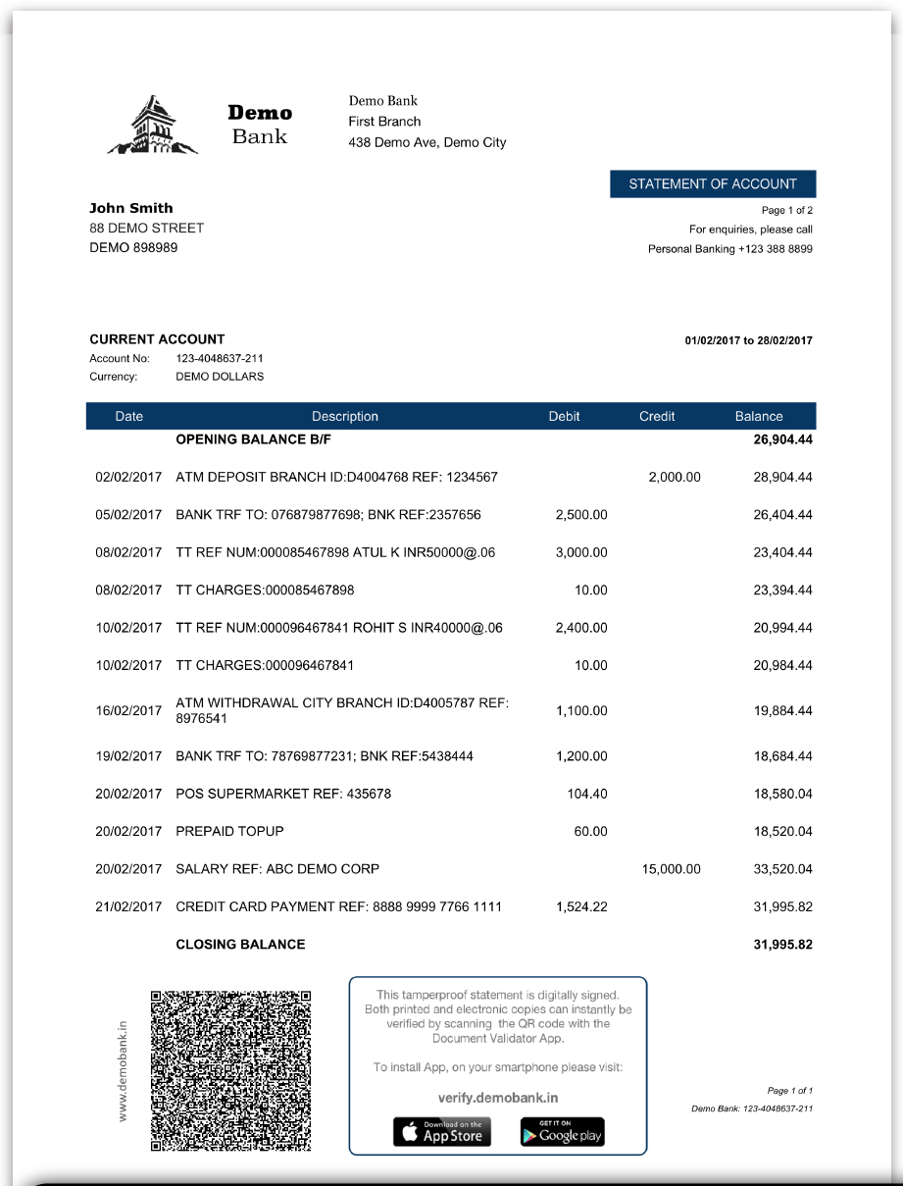

03
Choosing a QR System That Works
Existing Document Production System
Process's ease of use
Cost-effectiveness
Universality
Make simple and can be done across both electronic and physical formats.
Offer quickly and easily creating many tamper-proof documents
Provide an easy and universally understood verification process

Slide 17

Implementation of Secure Digitally Signed - QR Code
03
Verify any time on website configured for
each issuer
Contact a secure QR code service
Issue the document with a secure QR code
Step 1
Step 2
Step 3
Step 4
Step 5
Generate and Embed the generated secure QR code into your documents
Scanned the secure QR code on the document

Slide 18
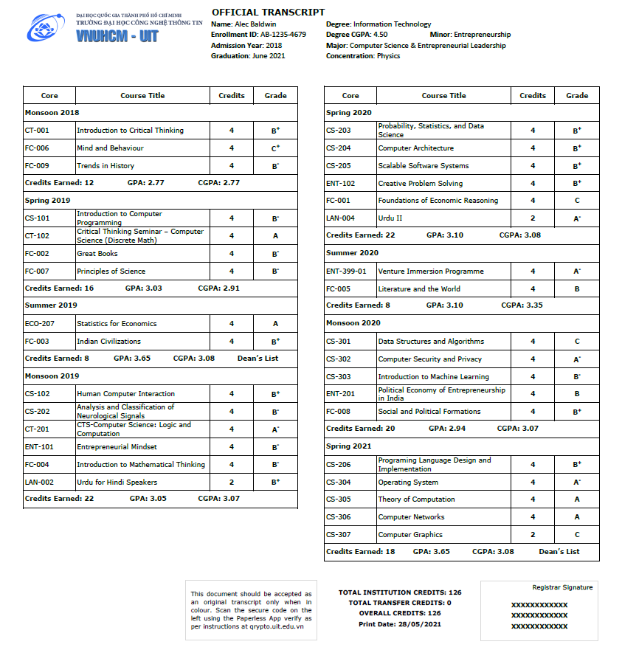
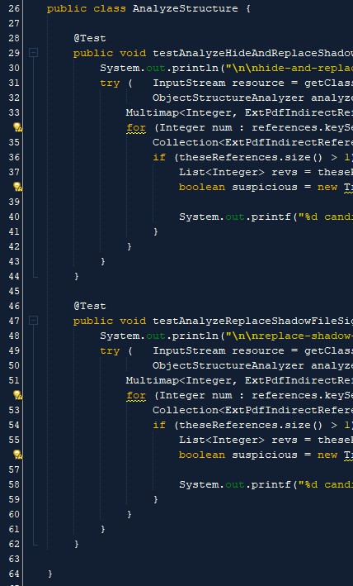

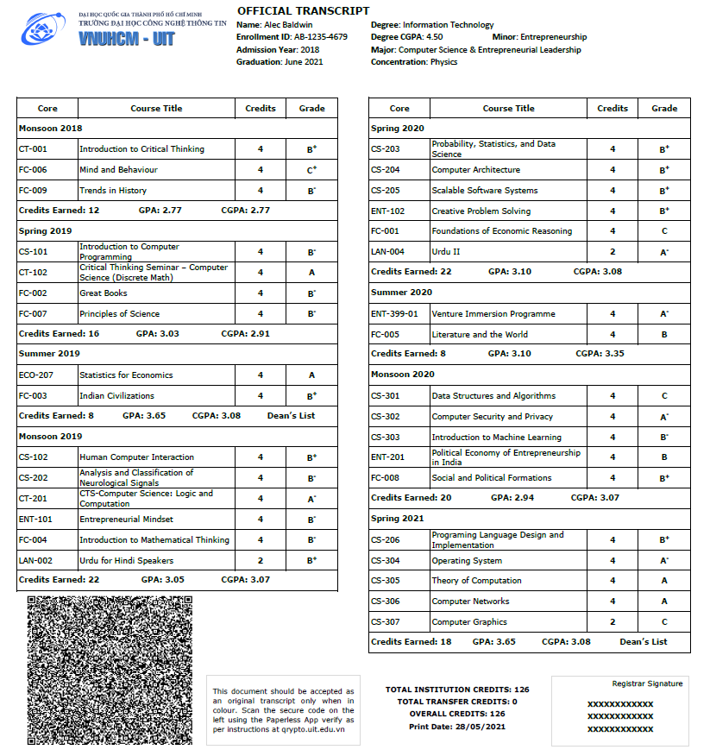

Implementation of Secure Digitally Signed - QR Code
03
Secure PDF Generation with one API call
PDF Template
Variable Data
Finished PDF
Instantly Verifiable
Tamperproof
Digitally signed

Slide 19





Elements of a Secure QR System
03
Authorized entity
Third party
Secure QR code
Signed by the issuer's private key
Done with the corresponding public key
Public key
Added with the necessary details to verify
Decrypts the critical information
Displays authenticated content to the verifier
A comprehensive solution for document security that includes several key elements

Slide 20
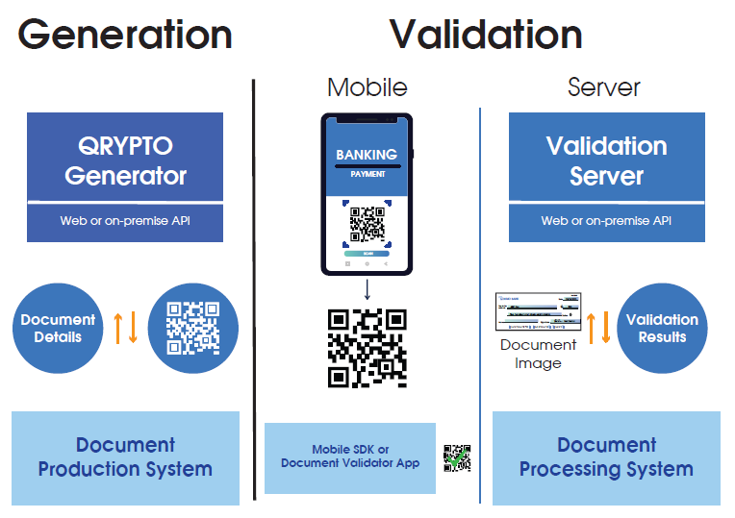
Secure QR Code generation & Validation architecture
03

Slide 21

04
Seamless Verification Experience
Blockchain vs. Secure QR Code

Slide 22
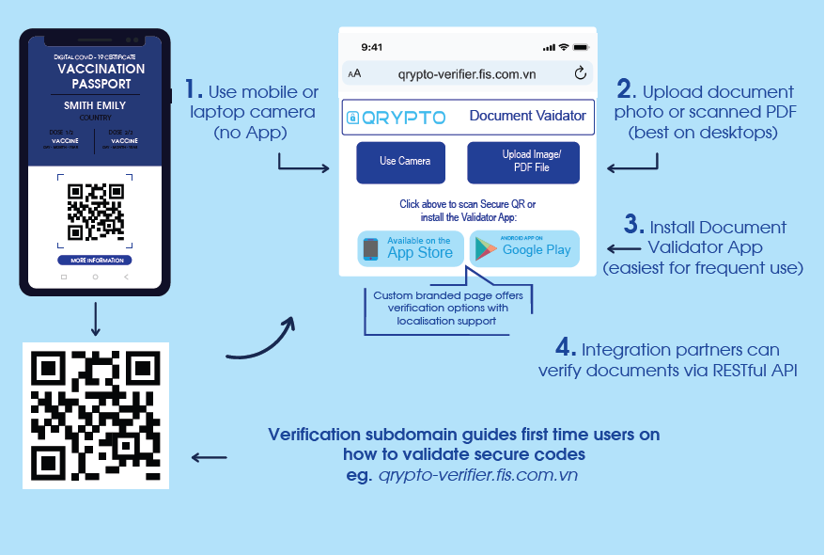


Seamless Verification Experience
04
Web validation
Mobile app
Validation server
Verify the information embedded in the secure QR code
Physical document
Electronic document

Slide 23
BLOCKCHAIN TECHNOLOGY
WHITEPAPER
DIGITAL SIGNATURES
SECURE
QR CODES
The increasing need for secure and tamper-proof documents in today's digital world has highlighted the importance of effective document security solutions
Each has its uses and limitations

Slide 24
SECURE
QR CODES
WHITEPAPER
BLOCKCHAIN TECHNOLOGY
DIGITAL SIGNATURES
The best of the other options and, in addition, are the most efficient and cost-effective solution for document security
Provide secure and tamper-proof documents in electronic and physical formats
Ease of verification and validation, secure QR codes are the preferred solution for organizations and individuals looking to secure documents

Slide 25
Thanks!
19 Dang Tien Dong , An Phu Ward, Thu Duc City, Ho Chi Minh City
028 3636 6015
info@mobile-id.vn

